Slide 1
DAGs and Topological Ordering
D
E
A directed acyclic graph (DAG) is a digraph that has no directed cycles
A topological ordering of a digraph is a numbering
v₁ , …, v_{n}
of the vertices such that for every edge (v_{i} , v_{j}), we have i < j
Example: in a task scheduling digraph, a topological ordering a task sequence that satisfies the precedence constraints
Theorem
A digraph admits a topological ordering if and only if it is a DAG
B
C
A
DAG G
v₄
v₅
D
E
v₂
B
v₃
v₁
C
Topological ordering of G
A
Directed Graphs

Slide 2

Topological Sorting
Number vertices, so that (u,v) in E implies u < v
wake up
1
A typical student day
2
3
eat
study computer sci.
4
5
nap
more c.s.
7
play
8
write c.s. program
6
9
work out
bake cookies
10
sleep
11
dream about graphs
Directed Graphs

Slide 3
Algorithm for Topological Sorting
Note: This algorithm is different than the one in the book
Running time: O(n + m)
Algorithm TopologicalSort(G)
H ← G // Temporary copy of G
n ← G.numVertices()
while H is not empty do
Let v be a vertex with no outgoing edges
Label v ← n
n ← n − 1
Remove v from H
Directed Graphs

Slide 4
Implementation with DFS
Simulate the algorithm by using depth-first search
O(n+m) time.
Algorithm topologicalDFS(G, v)
Input graph G and a start vertex v of G
Output labeling of the vertices of G
in the connected component of v
v.setLabel(VISITED)
  for all e ∈ v.outEdges()
  { outgoing edges }
  w ← e.opposite(v)
  if w.getLabel() = UNEXPLORED
  { e is a discovery edge }
  topologicalDFS(G, w)
  else
  { e is a forward or cross edge }
  Label v with topological number n
  n ← n - 1
Algorithm topologicalDFS(G)
Input dag G
Output topological ordering of G
n ← G.numVertices()
  for all u ∈ G.vertices()
  u.setLabel(UNEXPLORED)
  for all v ∈ G.vertices()
  if v.getLabel() = UNEXPLORED
  topologicalDFS(G, v)
Directed Graphs

Slide 5
Topological Sort Algorithm
We can use a DFS in our algorithm to determine a topological sort!
  The idea is:
    When you do a DFS on a directed acyclic graph, eventually you will reach a node with no outgoing edges. Why?
      Because if this never happened, you hit a cycle, because the number of nodes if finite.
    This node that you reach in a DFS is “safe” to place at the end of the topological sort.
      Think of leaving for work!
  Now what we find is
    If we have added each of the vertices “below” a vertex into our topological sort, it is safe then to add this one in.
      If we added in Leaving for work at the end, then we can surely add taking a shower.

Slide 6
Topological Sorting Example
Directed Graphs

Slide 7
Topological Sorting Example
9
Directed Graphs

Slide 8
Topological Sorting Example
8
9
Directed Graphs

Slide 9
Topological Sorting Example
7
8
9
Directed Graphs

Slide 10
Topological Sorting Example
6
7
8
9
Directed Graphs

Slide 11
Topological Sorting Example
6
5
7
8
9
Directed Graphs

Slide 12
Topological Sorting Example
4
6
5
7
8
9
Directed Graphs

Slide 13
Topological Sorting Example
3
4
6
5
7
8
9
Directed Graphs

Slide 14
Topological Sorting Example
2
3
4
6
5
7
8
9
Directed Graphs

Slide 15
Topological Sorting Example
2
1
3
4
6
5
7
8
9
Directed Graphs

Slide 16
Topological Sort: DFS
C
G
A
B
D
E
F
H

Slide 17
Topological Sort: DFS
C
dfs(A)
G
A
B
D
E
F
H

Slide 18
Topological Sort: DFS
C
dfs(A)
dfs(D)
G
A
B
D
E
F
H

Slide 19
Topological Sort: DFS
C
dfs(A)
dfs(D)
dfs(E)
G
A
B
D
E
F
H

Slide 20
Topological Sort: DFS
C
dfs(A)
dfs(D)
dfs(E)
dfs(F)
G
A
B
D
E
F
H

Slide 21
Topological Sort: DFS
C
dfs(A)
dfs(D)
dfs(E)
dfs(F)
dfs(H)
G
A
B
D
E
F
H

Slide 22
Topological Sort: DFS
C
dfs(A)
dfs(D)
dfs(E)
dfs(F)
G
A
B
D
E
F
H
7

Slide 23
Topological Sort: DFS
C
dfs(A)
dfs(D)
dfs(E)
G
A
B
D
E
F
6
H
7

Slide 24
Topological Sort: DFS
C
dfs(A)
dfs(D)
G
A
B
D
E
5
F
6
H
7

Slide 25
Topological Sort: DFS
C
dfs(A)
dfs(D)
G
A
B
D
E
5
F
6
H
7

Slide 26
Topological Sort: DFS
C
dfs(A)
G
A
B
D
E
4
5
F
6
H
7

Slide 27
Topological Sort: DFS
C
dfs(A)
G
A
B
D
E
4
5
F
6
H
7

Slide 28
Topological Sort: DFS
C
G
A
3
B
D
E
4
5
F
6
H
7

Slide 29
Topological Sort: DFS
C
dfs(B)
G
A
3
B
D
E
4
5
F
6
H
7

Slide 30
Topological Sort: DFS
C
dfs(B)
G
A
3
B
D
E
4
5
F
6
H
7

Slide 31
Topological Sort: DFS
C
G
A
3
B
2
D
E
4
5
F
6
H
7

Slide 32
Topological Sort: DFS
C
dfs(C)
G
A
3
B
2
D
E
4
5
F
6
H
7

Slide 33
Topological Sort: DFS
C
dfs(C)
G
A
3
B
2
D
E
4
5
F
6
H
7

Slide 34
Topological Sort: DFS
C
dfs(C)
G
A
3
B
2
D
E
4
5
F
6
H
7

Slide 35
Topological Sort: DFS
C
dfs(C)
G
A
3
B
2
D
E
4
5
F
6
H
7

Slide 36
Topological Sort: DFS
C
dfs(C)
dfs(G)
G
A
3
B
2
D
E
4
5
F
6
H
7

Slide 37
Topological Sort: DFS
C
dfs(C)
G
1
A
3
B
2
D
E
4
5
F
6
H
7

Slide 38
Topological Sort: DFS
0
C
G
1
A
3
B
2
D
E
4
5
F
6
H
7

Slide 39
Topological Sort: DFS
0
C
G
1
A
3
B
2
D
E
4
5
F
6
H
7
Topological order: C G B A D E F H

Slide 40
In the breadth first topological ordering we first find a vertex that has no predecessor vertex and place it first in the topological ordering.
We next find the vertex, say v, all of whose predecessors have been placed in the topological ordering and place v next in the topological ordering.
To keep track of the number of vertices of a vertex we use the array predCount.
Initially, predCount[j] is the number of predecessors of the vertex v_{j}.
The queue used to guide the breadth first traversal is initialized to those vertices v_{k} such that predCount[k] is zero.

Slide 41
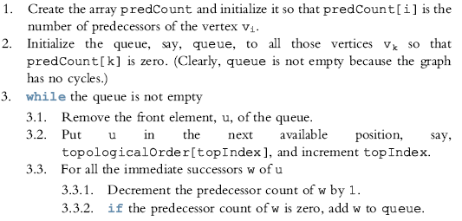
The general algorithm is:

Slide 42
More on Topological Sorting
Runs in O(n+m) time.
Useful starting point for many algorithms that involve acyclic graphs.

Slide 43
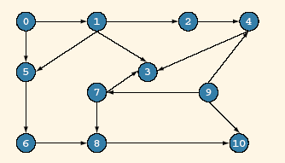
The vertices of G₃ in breadth first topological ordering are
0 9 1 7 2 5 4 6 3 8 10
We illustrate the breadth first topological ordering of the graph G₃

Slide 44
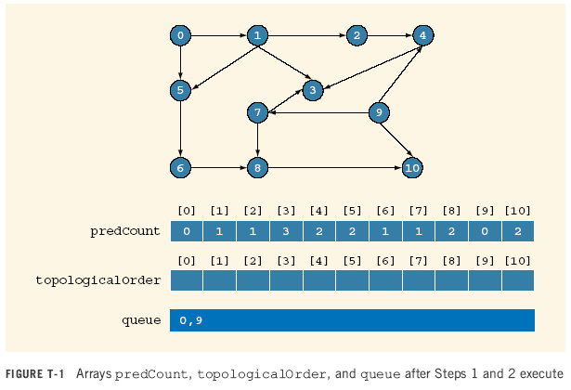

Slide 45
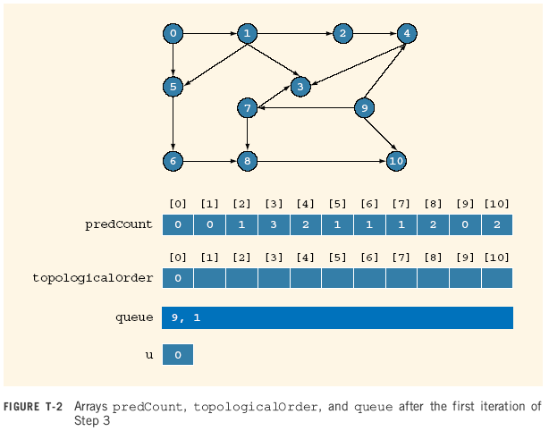

Slide 46


Slide 47


Slide 48
Pred Count
0 1 2 3 4 5 6 7 8 9 10
0 0 0 2 1 0 1 0 2 0 1
Topological order
0 9 1 7
queue
2 5
7

Slide 49
Pred Count
0 1 2 3 4 5 6 7 8 9 10
0 0 0 1 1 0 1 0 1 0 1
Topological order
0 9 1 7
queue
2 5
7

Slide 50
Pred Count
0 1 2 3 4 5 6 7 8 9 10
0 0 0 1 1 0 1 0 1 0 1
Topological order
0 9 1 7 2
queue
5
2

Slide 51
Pred Count
0 1 2 3 4 5 6 7 8 9 10
0 0 0 1 0 0 1 0 1 0 1
Topological order
0 9 1 7 2
queue
5 4
2

Slide 52
Pred Count
0 1 2 3 4 5 6 7 8 9 10
0 0 0 1 0 0 1 0 1 0 1
Topological order
0 9 1 7 2
queue
4
5

Slide 53
Pred Count
0 1 2 3 4 5 6 7 8 9 10
0 0 0 1 0 0 0 0 1 0 1
Topological order
0 9 1 7 2 5
queue
4 6
5

Slide 54
Pred Count
0 1 2 3 4 5 6 7 8 9 10
0 0 0 1 0 0 0 0 1 0 1
Topological order
0 9 1 7 2 5
queue
6
4

Slide 55
Pred Count
0 1 2 3 4 5 6 7 8 9 10
0 0 0 0 0 0 0 0 1 0 1
Topological order
0 9 1 7 2 5 4
queue
6 3
4

Slide 56
Pred Count
0 1 2 3 4 5 6 7 8 9 10
0 0 0 0 0 0 0 0 1 0 1
Topological order
0 9 1 7 2 5 4 6
queue
3
6

Slide 57
Pred Count
0 1 2 3 4 5 6 7 8 9 10
0 0 0 0 0 0 0 0 0 0 1
Topological order
0 9 1 7 2 5 4 6
queue
3 8
6

Slide 58
Pred Count
0 1 2 3 4 5 6 7 8 9 10
0 0 0 0 0 0 0 0 0 0 1
Topological order
0 9 1 7 2 5 4 6 3
queue
8
3

Slide 59
Pred Count
0 1 2 3 4 5 6 7 8 9 10
0 0 0 0 0 0 0 0 0 0 1
Topological order
0 9 1 7 2 5 4 6 3 8
queue
8

Slide 60
Pred Count
0 1 2 3 4 5 6 7 8 9 10
0 0 0 0 0 0 0 0 0 0 0
Topological order
0 9 1 7 2 5 4 6 3 8
queue
10
8

Slide 61
Pred Count
0 1 2 3 4 5 6 7 8 9 10
0 0 0 0 0 0 0 0 0 0 0
Topological order
0 9 1 7 2 5 4 6 3 8 10
queue
10

Slide 62
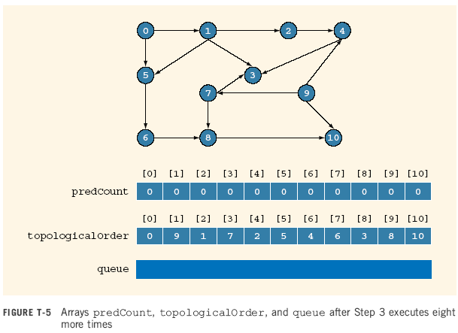

Slide 63
Find a topological order for the following graph
H
E
I
A
D
G
J
C
F
K
B
L

Slide 64
Find a topological order for the following graph
E
H
I
A
D
G
J
C
F
K
B
L
Pred Count
A B C D E F G H I J K L
0 1 1 3 1 2 3 0 0 2 1 3
Topological order
queue
A H I

Slide 65
Find a topological order for the following graph
E
H
I
A
D
G
J
C
F
K
B
L
Pred Count
A B C D E F G H I J K L
0 1 1 3 1 2 3 0 0 2 1 3
Topological order
A
queue
H I
A

Slide 66
Find a topological order for the following graph
E
H
I
D
G
J
C
F
K
B
L
Pred Count
A B C D E F G H I J K L
0 1 0 2 0 2 3 0 0 2 1 3
Topological order
A
queue
H I C E
A

Slide 67
Find a topological order for the following graph
E
H
I
D
G
J
C
F
K
B
L
Pred Count
A B C D E F G H I J K L
0 1 0 2 0 2 3 0 0 2 1 3
Topological order
A H
queue
I C E
H

Slide 68
Find a topological order for the following graph
E
I
D
G
J
C
F
K
B
L
Pred Count
A B C D E F G H I J K L
0 1 0 2 0 2 2 0 0 2 1 3
Topological order
A H
queue
I C E
H

Slide 69
Find a topological order for the following graph
E
I
D
G
J
C
F
K
B
L
Pred Count
A B C D E F G H I J K L
0 1 0 2 0 2 2 0 0 2 1 3
Topological order
A H I
queue
C E
I

Slide 70
Find a topological order for the following graph
E
D
G
J
C
F
K
B
L
Pred Count
A B C D E F G H I J K L
0 1 0 2 0 2 1 0 0 1 1 3
Topological order
A H I
queue
C E
I

Slide 71
Find a topological order for the following graph
E
D
G
J
C
F
K
B
L
Pred Count
A B C D E F G H I J K L
0 1 0 2 0 2 1 0 0 1 1 3
Topological order
A H I C
queue
E
C

Slide 72
Find a topological order for the following graph
E
D
G
J
F
K
B
L
Pred Count
A B C D E F G H I J K L
0 0 0 2 0 1 1 0 0 1 1 3
Topological order
A H I C
queue
E B
C

Slide 73
Find a topological order for the following graph
E
D
G
J
F
K
B
L
Pred Count
A B C D E F G H I J K L
0 0 0 2 0 1 1 0 0 1 1 3
Topological order
A H I C E
queue
B
E

Slide 74
Find a topological order for the following graph
D
G
J
F
K
B
L
Pred Count
A B C D E F G H I J K L
0 0 0 1 0 1 1 0 0 1 1 3
Topological order
A H I C E
queue
B
E

Slide 75
Find a topological order for the following graph
D
G
J
F
K
L
Pred Count
A B C D E F G H I J K L
0 0 0 1 0 1 1 0 0 1 1 3
Topological order
A H I C E B
queue
B

